Slide 1

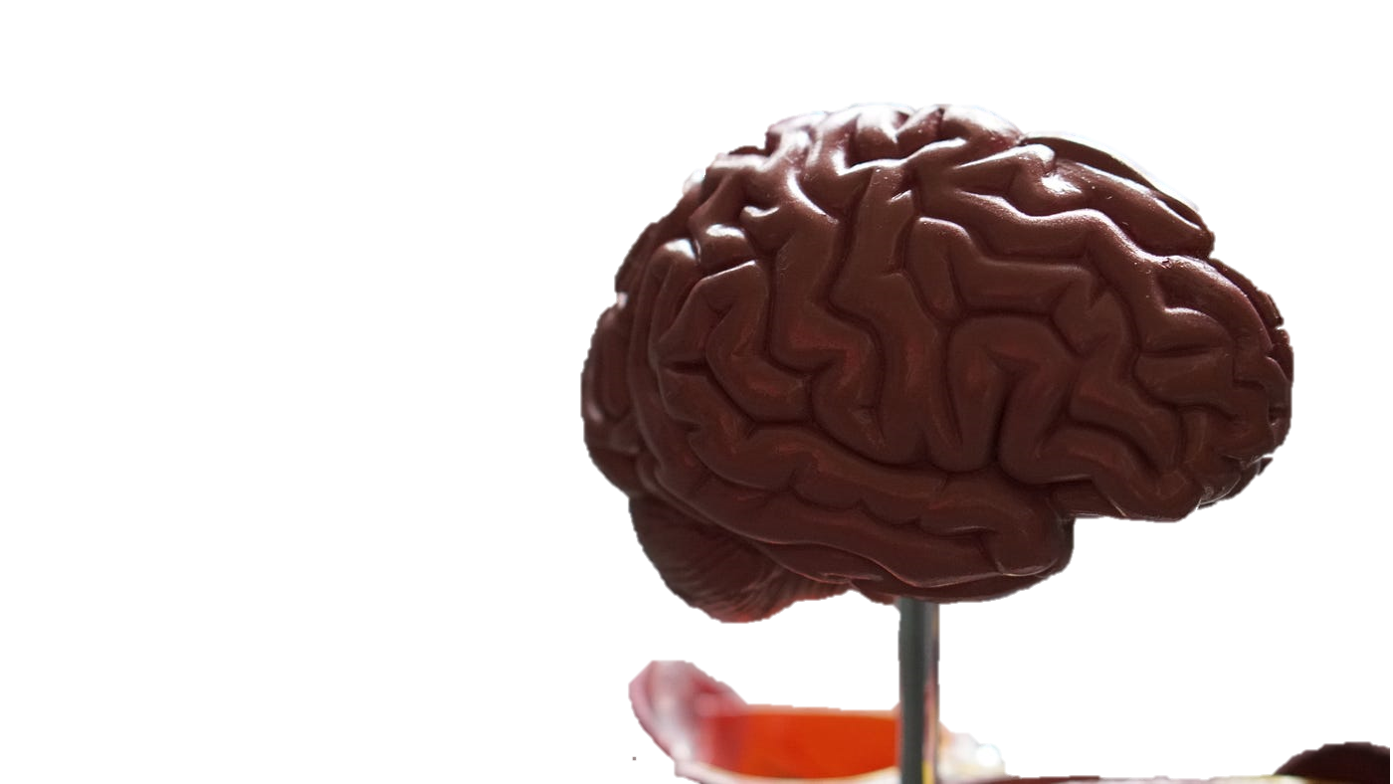
STROKE PREDICTION
By Machine Learning Techniques
BUAN 6341.003 Applied Machine Learning
Prof. Shaojie Tang
Presented By:
Farhad Azadjoutabari
Ritin Wadekar

Slide 2
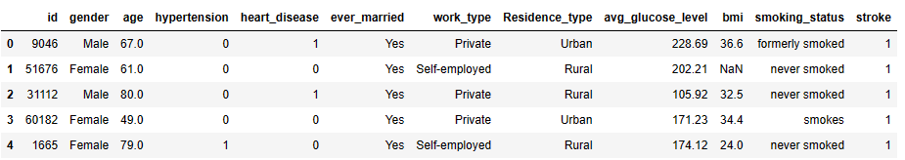
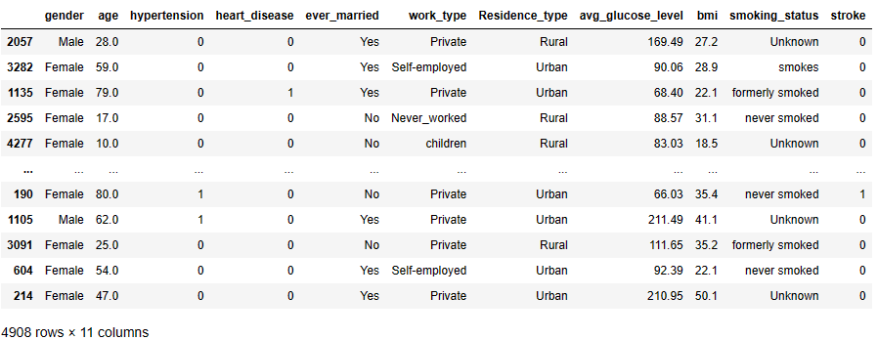
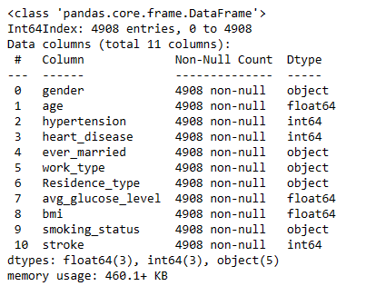
Data Description
Preprocessing
It does not have any meaning and effect on stroke, so we remove this column from the table.
There are 201 observations that have Null value for the bmi column.
It’s around 4% of total count of observation. Therefore, we omit all the rows with Nan values.
Final Dataset

Slide 3
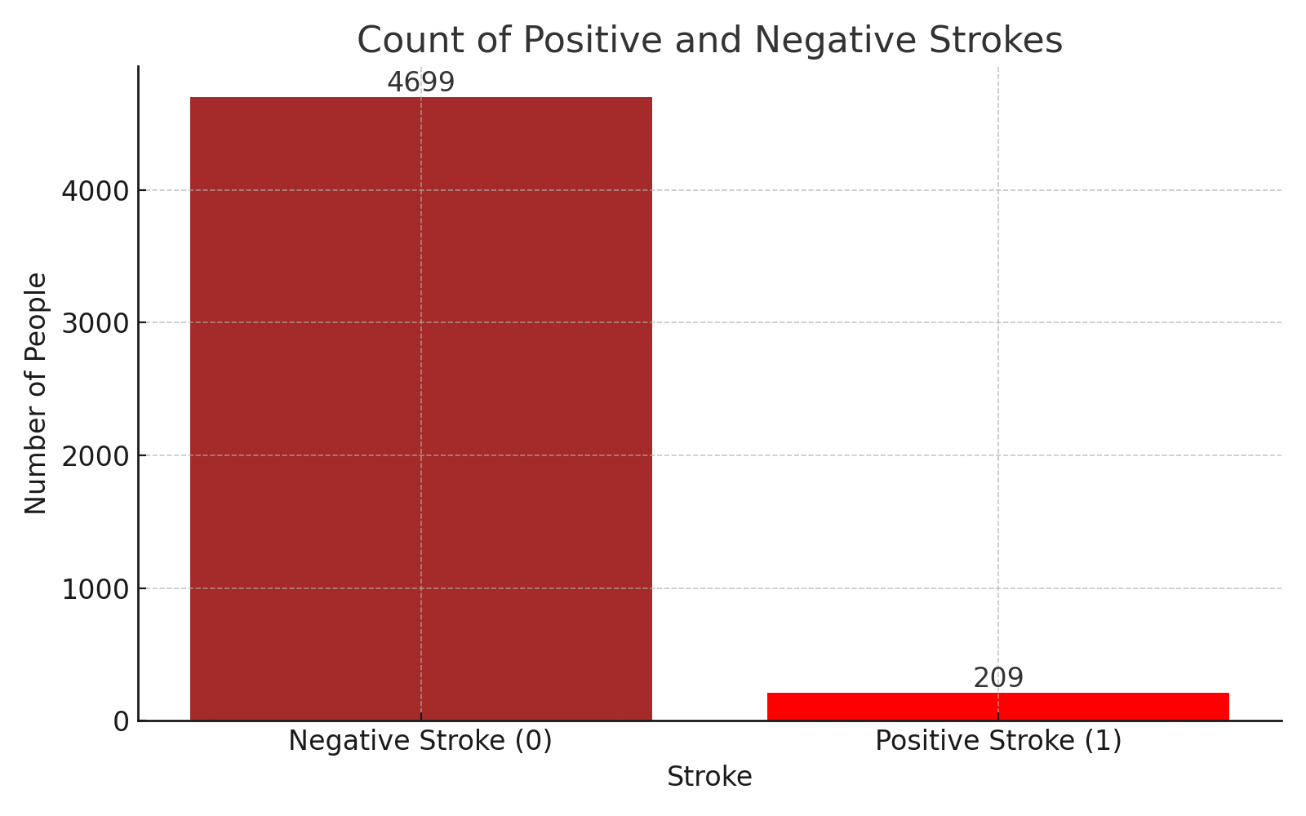
The Data is Highly Imbalanced!

Slide 4
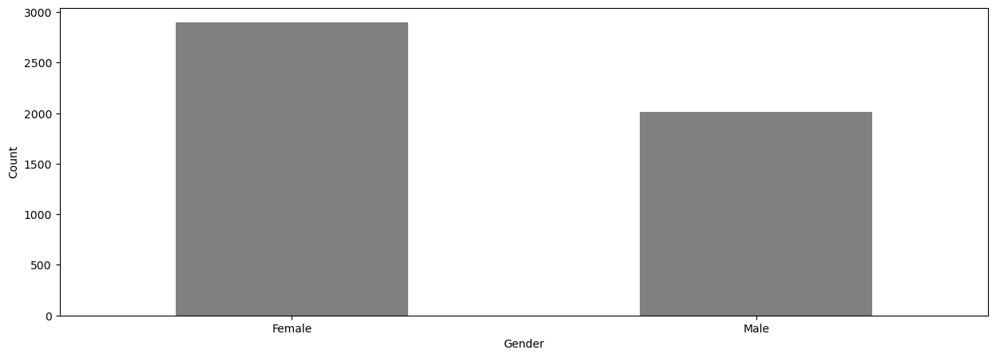
Data Exploration
Gender Effect
2897
2011
Gender-Stroke Frequency Table |  | Stroke
 |  | 0 | 1
Gender | Male | 95.86% | 4.14%
 | Female | 95.57% | 4.43%
There is not any significant difference between male and females in stroke probability.

Slide 5
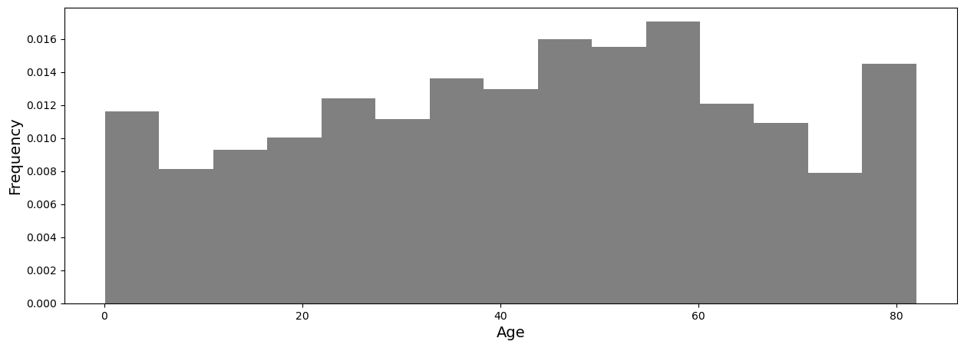
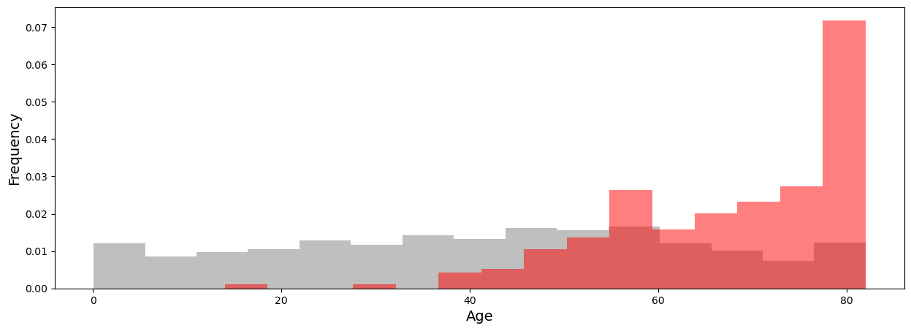
Data Exploration
Age Effect
Age histogram without stroke is distributed pretty uniformly.
Age histogram with stroke is left-skewed. The probability of stroke for older people is higher than younger.

Slide 6
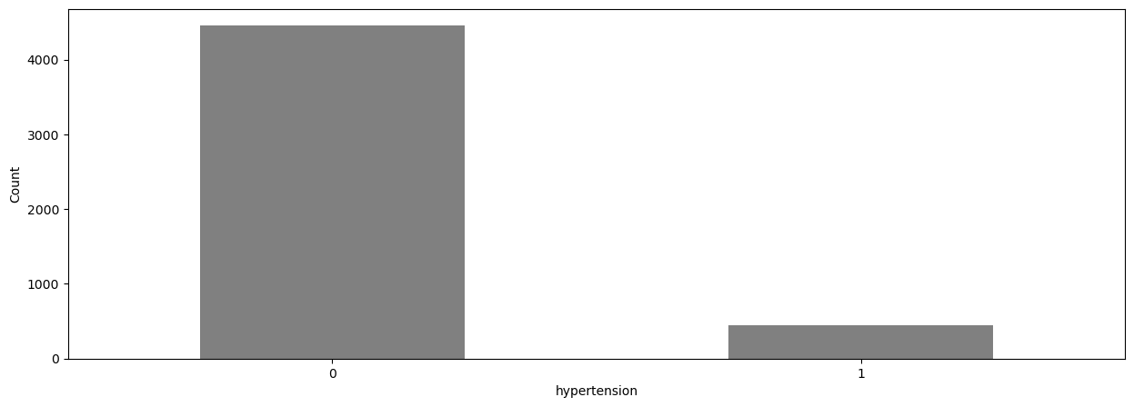
Data Exploration
Hypertension Effect
4457
451
Hypertension-Stroke Frequency Table |  | Stroke
 |  | 0 | 1
Hypertension | 0 | 96.66% | 3.34%
 | 1 | 86.70% | 13.30%
There is significant impact of hypertension on the stroke probability.

Slide 7
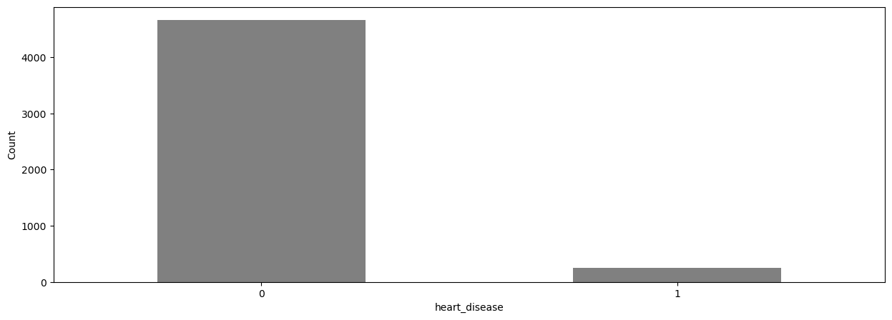
Data Exploration
Heart Disease Effect
4665
243
Heart Disease-Stroke Frequency Table |  | Stroke
 |  | 0 | 1
Heart Disease | 0 | 96.38% | 3.62%
 | 1 | 83.54% | 16.46%
There is significant impact of heart disease on the stroke probability.

Slide 8
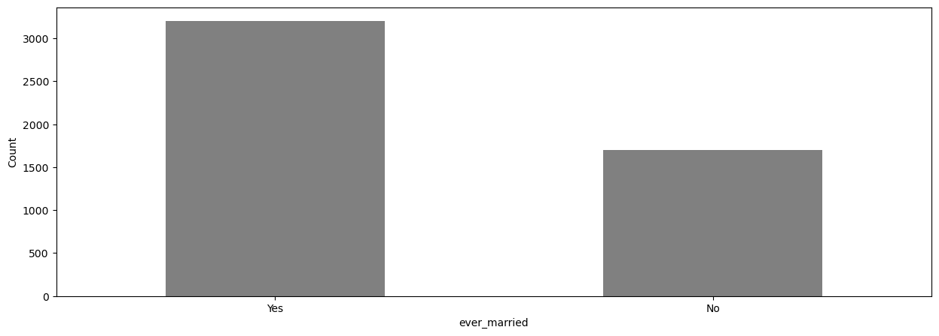
Data Exploration
Marriage Effect
3204
1704
Marriage-Stroke Frequency Table |  | Stroke
 |  | 0 | 1
Ever Married | 0 | 98.65% | 1.35%
 | 1 | 94.19% | 5.81%
It seems there is some sort of effects on stroke probability according to marriage status.

Slide 9
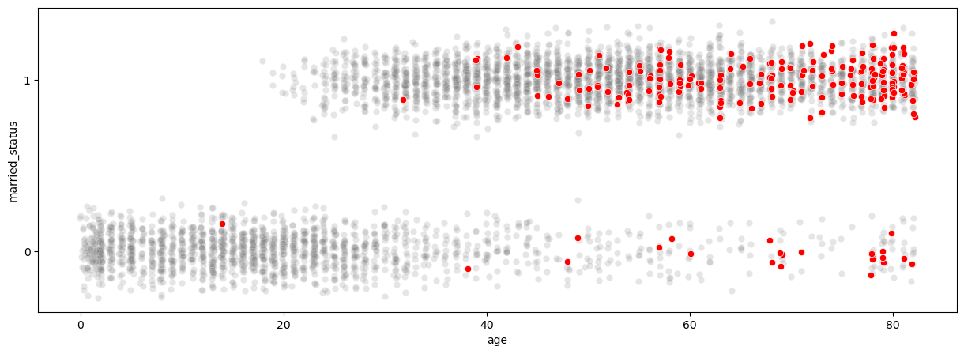
Data Exploration
Marriage Effect
There is a shift in data for two different marriage groups. Most of the observations who are married are older than the majority of observations who are not married. Therefore, the high number of stroke for married people can be related to their age rather than their marriage.
Another observation here is even for not married people the probability of stroke for older people is much more than younger one.
We can conclude that this correlation is because of the age not marriage.

Slide 10
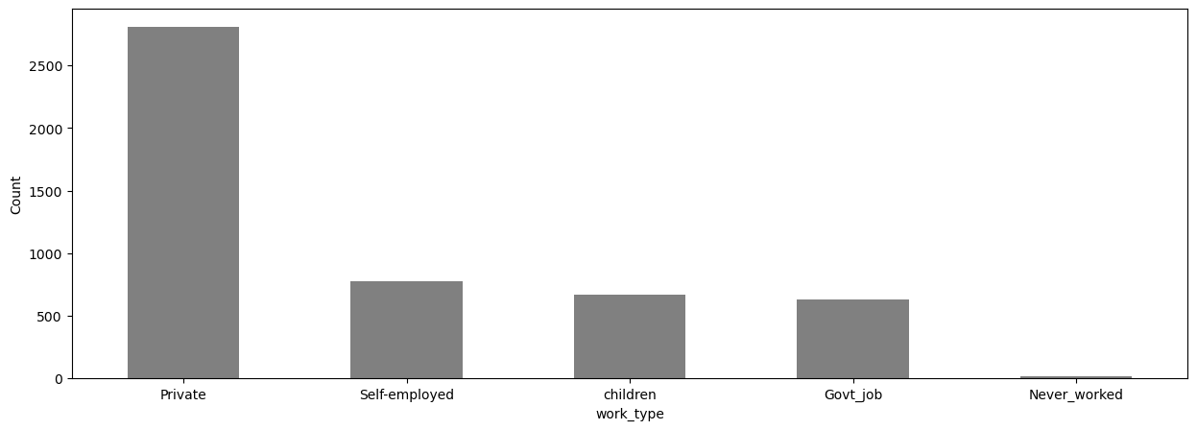
Data Exploration
Carrier Effect
 |  | Work Type
 |  | Private | Self-employed | Govt-job | Children work-type | Never worked
Stroke | 0 | 95.48% | 93.16% | 95.55% | 99.85% | 100%
 | 1 | 4.52% | 6.84% | 4.45% | 0.15% | 0%

Slide 11
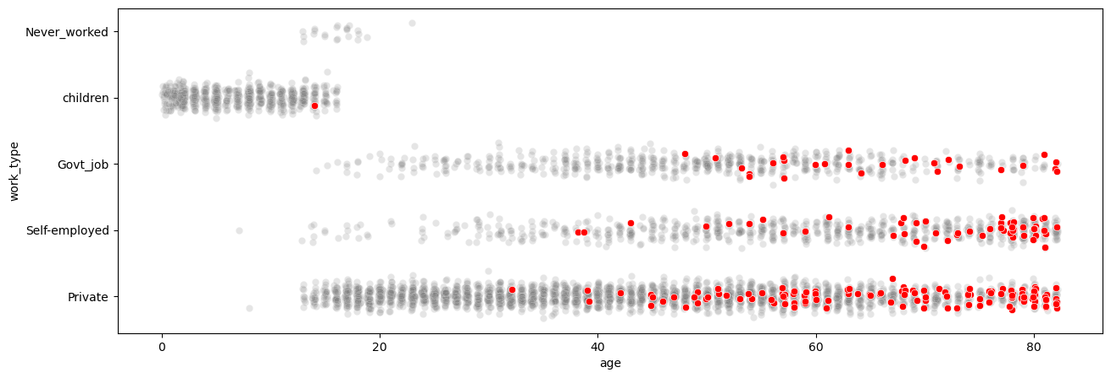
Data Exploration
Carrier Effect
As we can see the work_type does not show any significant impact on stroke probability. Based on the chart above, by increasing the age, the probability of stroke will increase. It is obvious that the never worked and children group have younger age, so the stroke probability is very low.
The difference in stroke density is because of the difference in groups population.

Slide 12
Data Exploration
Smoking and heart disease Effect
Stroke Probability | Heart Disease
Smoking Status | 0 | 1 | %change
Unknown | 1.73% | 10.81% | +9.08%
Formerly Smoked | 5.87% | 17.14% | +11.27%
Never Smoked | 4.12% | 13.58% | +9.46%
Smokes | 3.81% | 23.64% | +19.83%

Slide 13
Data Exploration
Smoking and hypertension Effect
Stroke Probability | Hypertension
Smoking Status | 0 | 1 | %change
Unknown | 1.81% | 6.98% | +5.17%
Formerly Smoked | 5.51% | 15.45% | +9.94%
Never Smoked | 3.30% | 13.89% | +10.59%
Smokes | 4.43% | 12.20% | +7.77%

Slide 14
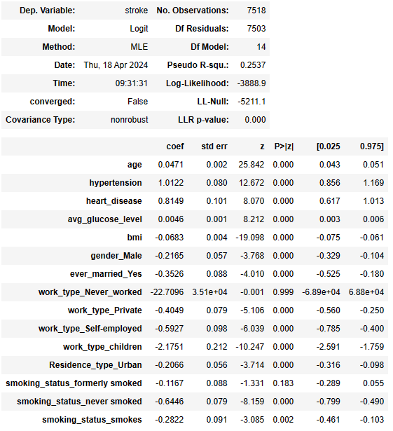
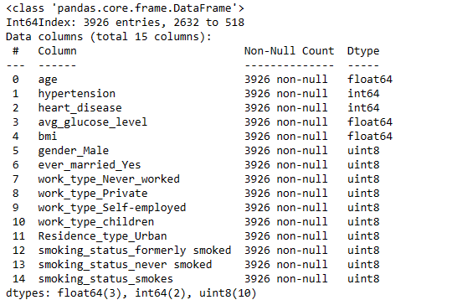
Modeling
Logistic Regression
Train Dataset with dummy variables
Except these two variables, other predictors seems significant

Slide 15
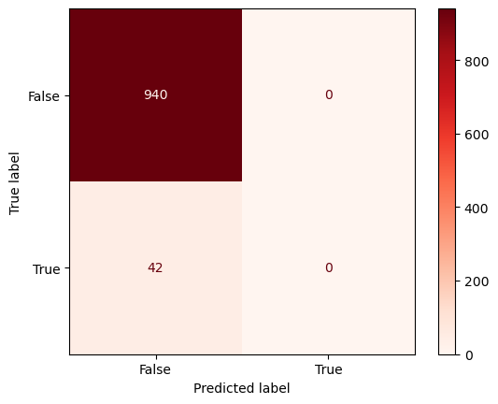
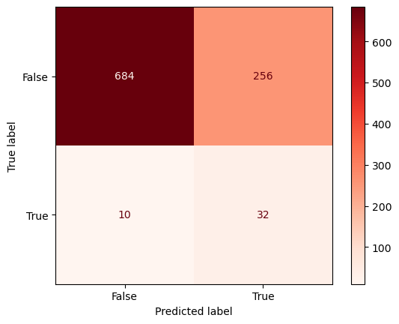

Modeling
Logistic Regression
Without sampling
Oversampling
Undersampling
Accuracy: 95.72% Naive Model Accuracy: 95.74% F1-score: 0.0 recall: 0.0 | Accuracy: 72.91% Naive Model Accuracy: 95.74% F1-score: 0.1939 recall: 0.7619 | Accuracy: 73.52% Naive Model Accuracy: 95.74% F1-score: 0.1925 recall: 0.7381

Slide 16
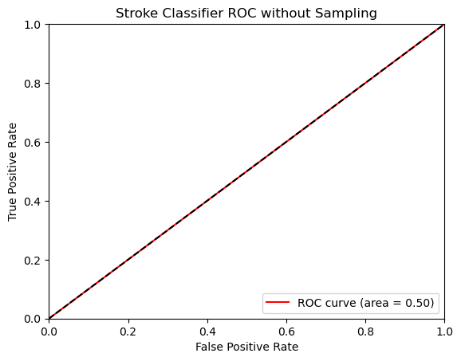
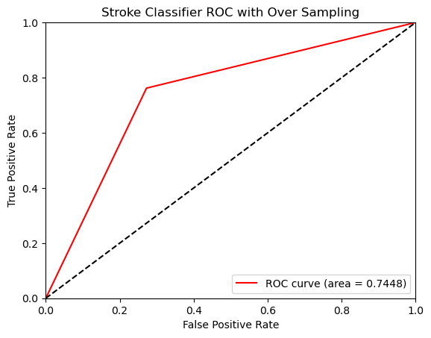
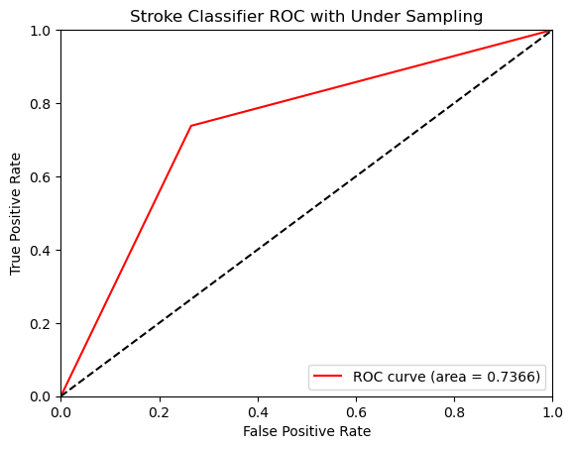
Modeling ROC
Logistic Regression
Without sampling
Oversampling
Undersampling
Accuracy: 95.72% Naive Model Accuracy: 95.74% F1-score: 0.0 recall: 0.0 | Accuracy: 72.91% Naive Model Accuracy: 95.74% F1-score: 0.1939 recall: 0.7619 | Accuracy: 73.52% Naive Model Accuracy: 95.74% F1-score: 0.1925 recall: 0.7381

Slide 17

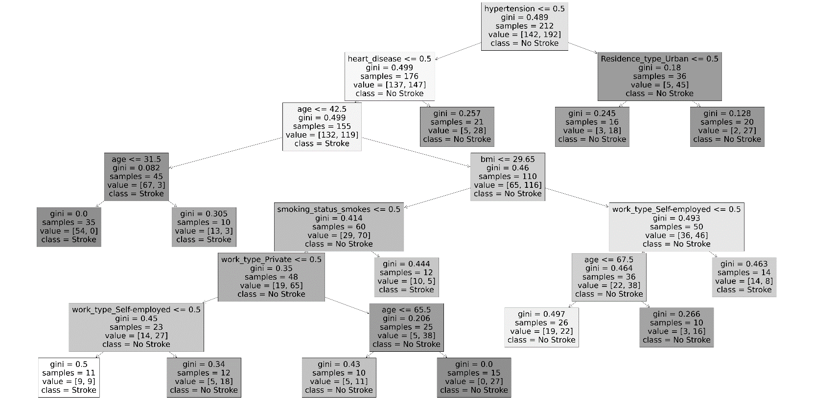
Modeling
Random Forest
The forest has 30 decision trees. This tree is one of these trees that built the forest. It cannot represent the feature importance, so we build the chart to show them.

Slide 18
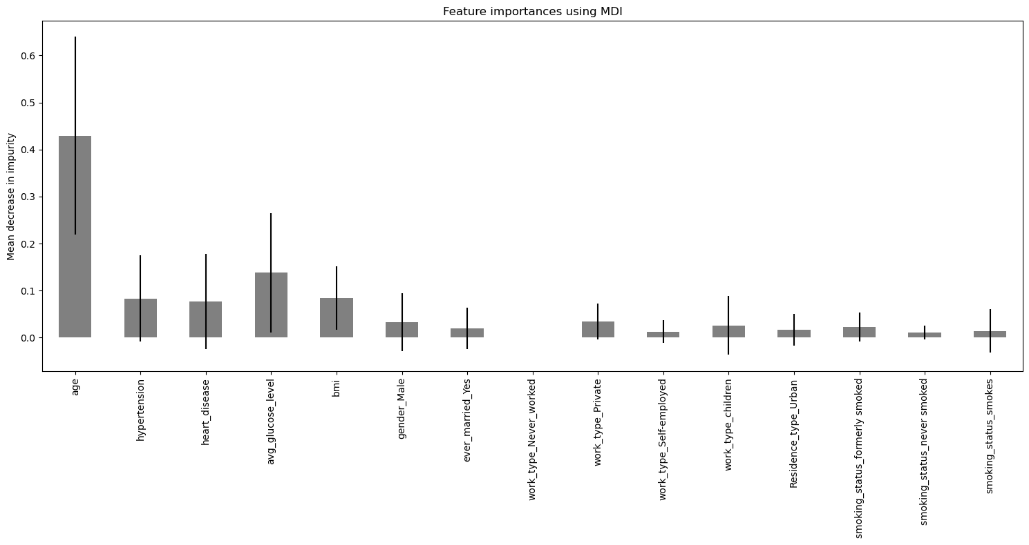
Modeling
Random Forest
The top 5 features that classify the stroke is as follows:
1- Age
2- Average glucose level
3- Hypertension
4- BMI
5- Heart disease

Slide 19
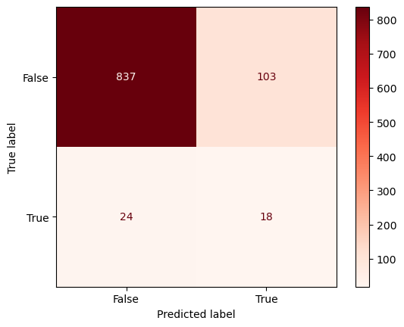
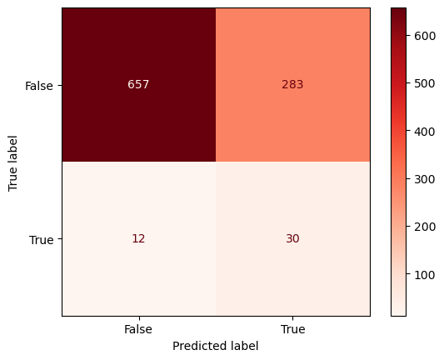
Modeling
Random Forest
Without sampling
Oversampling
Undersampling
Accuracy: 95.72% Naive Model Accuracy: 95.74% F1-score: 0.0 recall: 0.0 | Accuracy: 87.06% Naive Model Accuracy: 95.74% F1-score: 0.2208 recall: 0.4285 | Accuracy: 69.96% Naive Model Accuracy: 95.74% F1-score: 0.1690 recall: 0.7143

Slide 20
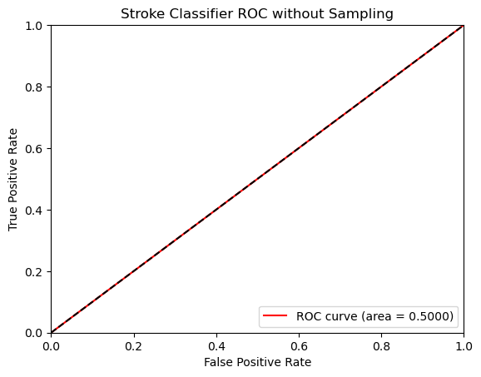
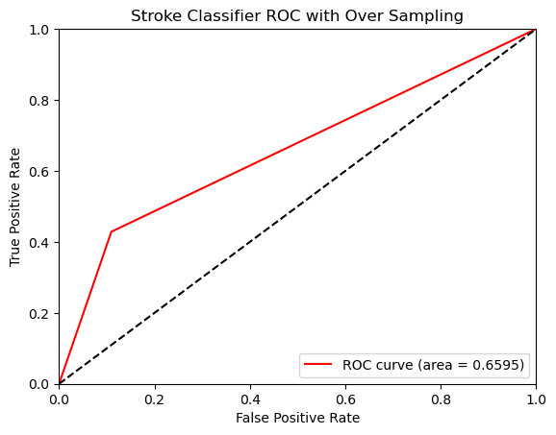
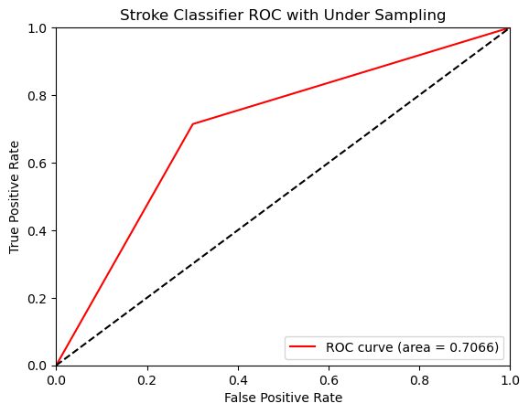
Modeling ROC
Random Forest
Without sampling
Oversampling
Undersampling
Accuracy: 95.72% Naive Model Accuracy: 95.74% F1-score: 0.0 recall: 0.0 | Accuracy: 87.06% Naive Model Accuracy: 95.74% F1-score: 0.2208 recall: 0.4285 | Accuracy: 69.96% Naive Model Accuracy: 95.74% F1-score: 0.1690 recall: 0.7143

Slide 21
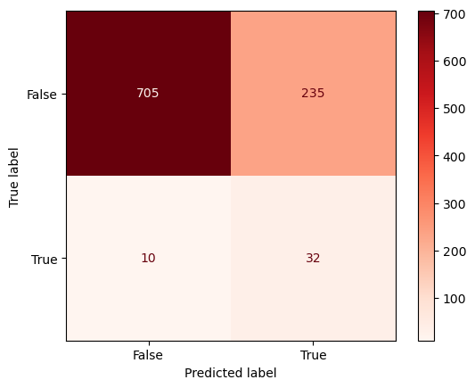
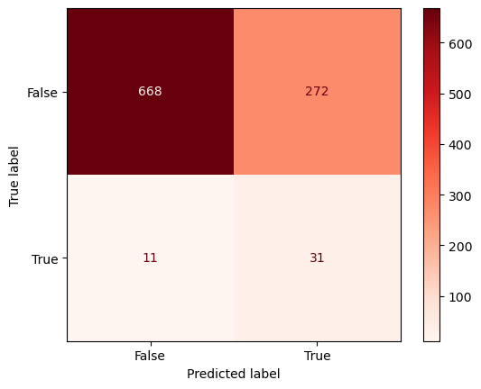
Modeling
Multi-Layer Perceptron (MLP)
Without sampling
Oversampling
Undersampling
Accuracy: 95.72% Naive Model Accuracy: 95.74% F1-score: 0.0 recall: 0.0 | Accuracy: 75.05% Naive Model Accuracy: 95.74% F1-score: 0.2071 recall: 0.7619 | Accuracy: 71.18% Naive Model Accuracy: 95.74% F1-score: 0.1797 recall: 0.7381

Slide 22
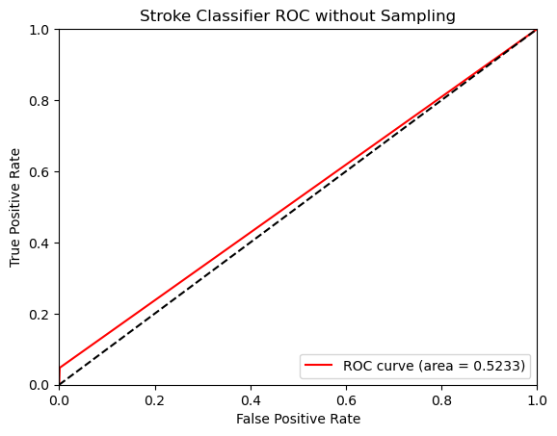
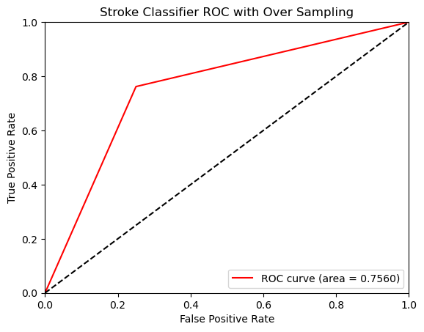

Modeling ROC
Multi-Layer Perceptron (MLP)
Without sampling
Oversampling
Undersampling
Accuracy: 95.72% Naive Model Accuracy: 95.74% F1-score: 0.0 recall: 0.0 | Accuracy: 75.05% Naive Model Accuracy: 95.74% F1-score: 0.2071 recall: 0.7619 | Accuracy: 71.18% Naive Model Accuracy: 95.74% F1-score: 0.1797 recall: 0.7381

Slide 23
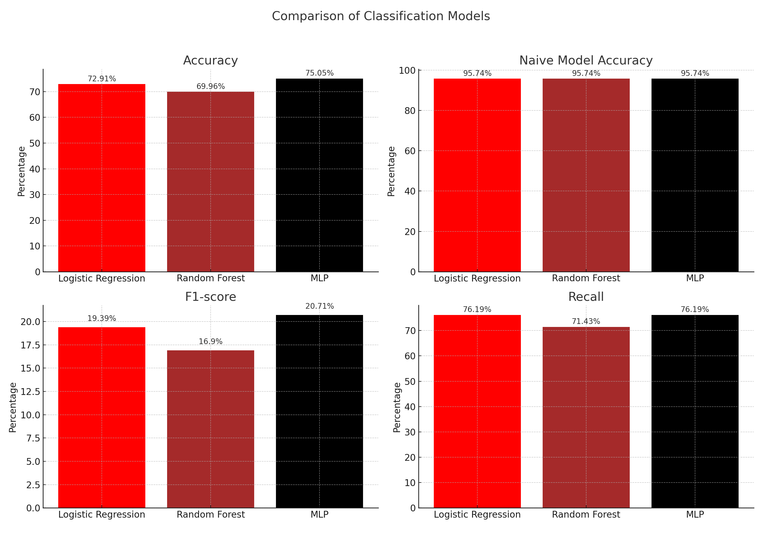
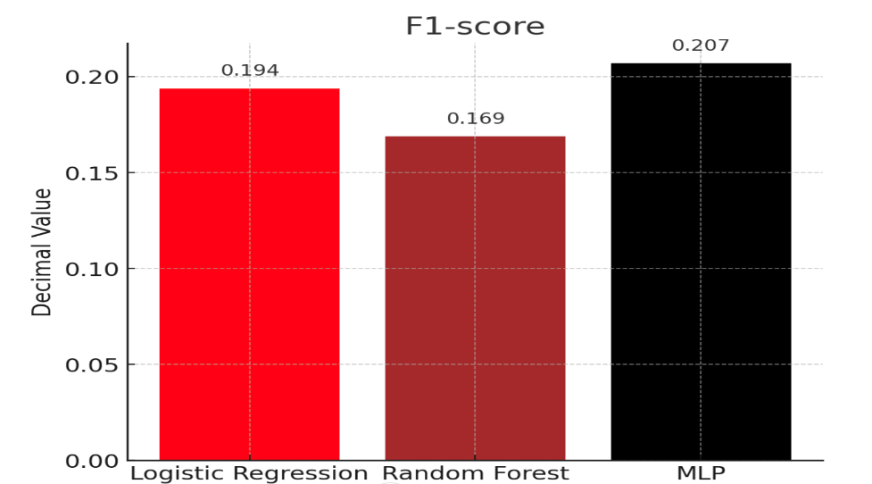
Which is the best Model? MLP

Slide 24
THANK YOU
Any Question?

